Slide 1
ROME Therapeutics RPT-002950
Update #06
Date: July 28th 2023
CONFIDENTIAL

Slide 2
RPT-3575: Optimization of Oxidation Step
Main goal of the project is to optimize oxidation step
  Reduce/eliminate dimethyl sulfide from Swern-like conditions
  Over-oxidation has occurred with some conditions

Slide 3
Oxidation: TEMPO/NaClO
Entry # | Scale | Description | Comments
1 | 5 g | RPT-3574 (5 g, 1 eq), NaClO (1.25 eq, pH = 9.4), TEMPO (0.1 eq), NaBr (0.2 eq), DCM (125 mL), NaHCO₃ + K₂CO₃ (125 mL, pH = 9.2), 5-15 °C, 1 h | Scale-up to carry through to 3576 HPLC: RPT-3574 (1.3%); RPT-3575 (96.5%), RPT-2950-1B (2.2%) HPLC – Aq. Layer indicated more acid; will continue to monitor in subsequent trials Aqueous quench & extractive workup done; crude used in next steps (Slide 6, Entry 1) Emulsion noted during extraction ¹H-NMR of crude aldehyde recorded; in agreement with expected structure
2 | 5 g | RPT-3574 (5 g, 1 eq), NaClO (1.25 eq, pH = 9.5), TEMPO (0.1 eq), NaBr (0.2 eq), DCM (50 mL), NaHCO₃ + K₂CO₃ (50 mL, pH = 9.2), 5-15 °C, 1 h | Reduced solvent to 10 V each layer for reaction HPLC: RPT-3574 (9.0%); RPT-3575 (88.2%), RPT-2950-1B (2.1%) Aqueous quench & extractive workup done; crude used in next steps (Slide 8, Entry 2) MTBE added in extraction for better separation
CONFIDENTIAL

Slide 4
HPLC Entry 1: TEMPO/NaClO (1 h) – Organic Layer
3574
3575
2950-1B
CONFIDENTIAL

Slide 5
HPLC Entry 1: TEMPO/NaClO (1 h) – Aqueous Layer
3574
2950-1B
3575
CONFIDENTIAL

Slide 6
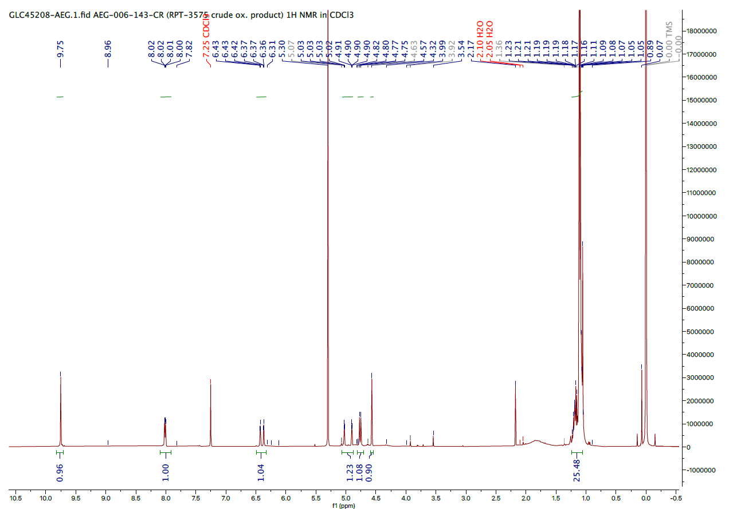
¹H-NMR Entry 1: RPT-3575 After Workup
CONFIDENTIAL

Slide 7
HPLC Entry 2: TEMPO/NaClO (1 h)
3574
3575
2950-1B
CONFIDENTIAL

Slide 8
Formylation/Reduction on RPT-3575
Entry # | Scale | Description | Comments
1 | ~5 g | RPT-3575 (~5 g, 1 eq), H₂C=O (37% aq, 5 mL, 2 V, ~10 eq), NaOH (2 M, 5.5 mL, 2.2 V, ~5 eq), Dioxane (25 mL), RT, O/N Then: NaBH₄ (2.5 eq), 10 °C-RT, 4 h | Reactions, workup and crystallization conducted as per process description Obtained: 2.85 g (53% over 3 steps) NMR in agreement with desired structure LCMS: m/z = 451⁺ [M+H]⁺ HPLC: (87.5%), indicates presence of acid (1.4%) as impurity
2 | ~5 g | RPT-3575 (~5 g, 1 eq) H₂C=O (37% aq, 10 mL, 2 V, ~10 eq), NaOH (2 M, 11 mL, 2.2 V, ~5 eq), Dioxane (50 mL), RT, O/N Then: NaBH₄ (2.5 eq), 10 °C-RT, 4 h | Reactions, workup and crystallization conducted as per process description Obtained: 3.58 g (67% over 3 steps) NMR in agreement with desired structure LCMS: mz/ = 451⁺ [M+H]⁺ HPLC: (78.7%), indicates presence of acid (5.3%) as an impurity; Unknown impurity 10.1%; suspected to be RPT-3574
CONFIDENTIAL

Slide 9
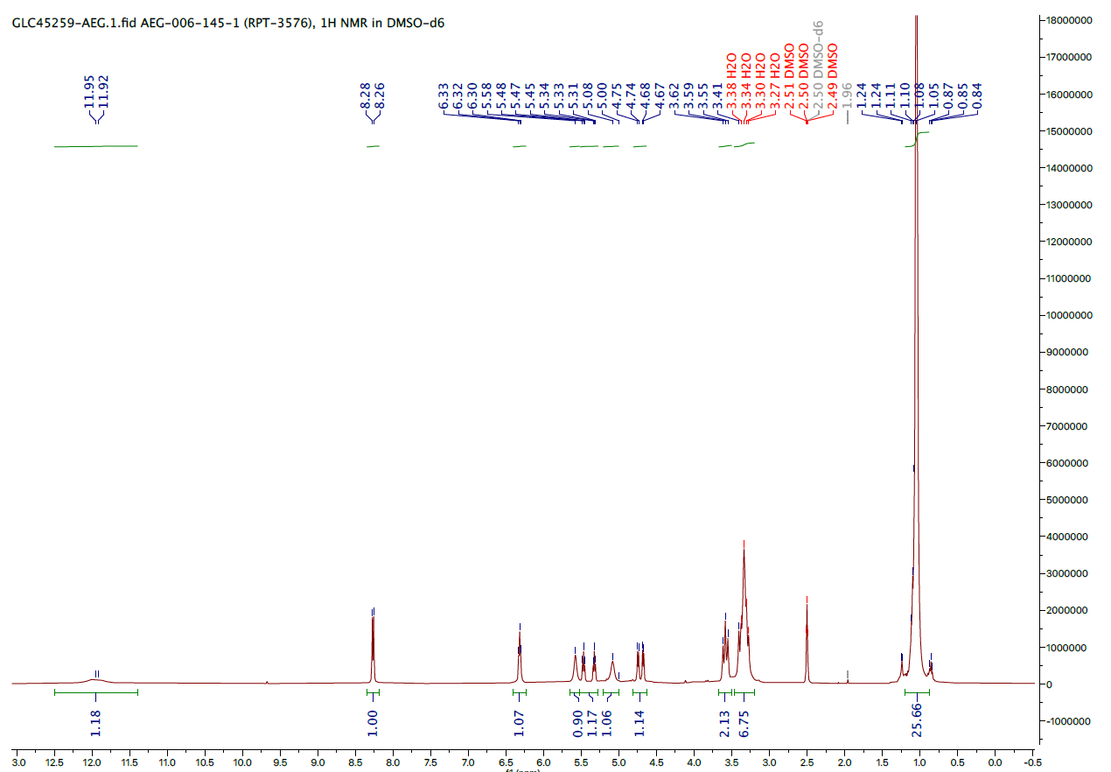
¹H NMR: Entry 1 – RPT-3576
CONFIDENTIAL

Slide 10
LCMS: Entry 1 – RPT-3576
CONFIDENTIAL

Slide 11
HPLC: Entry 1 – RPT-3576
CONFIDENTIAL

Slide 12
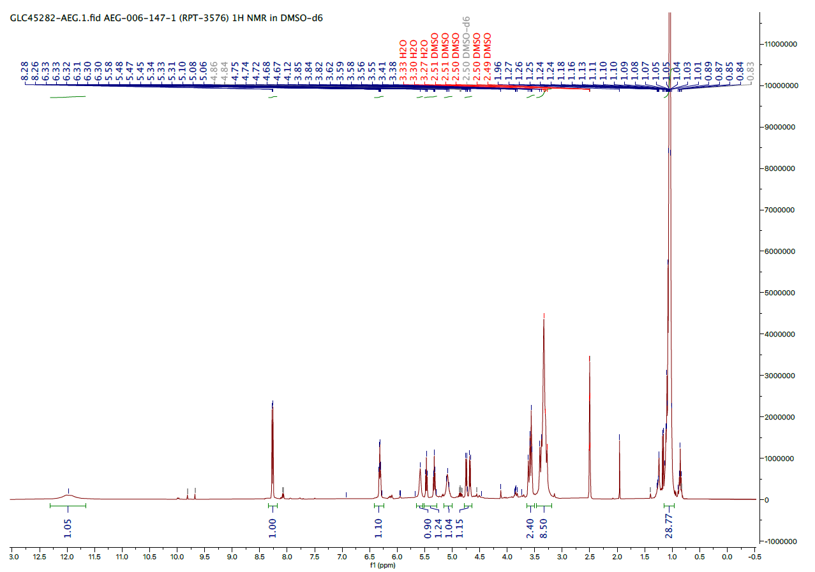
¹H NMR: Entry 2 – RPT-3576
CONFIDENTIAL

Slide 13
LCMS: Entry 2 – RPT-3576
CONFIDENTIAL

Slide 14
HPLC: Entry 2 – RPT-3576
CONFIDENTIAL

Slide 15
Oxidation: TEMPO/NaClO (MTBE)
Entry # | Scale | Description | Comments
1 | 200 mg | RPT-3574 (200 mg, 1 eq), NaClO (1.25 eq, pH 9.5), TEMPO (0.1 eq), NaBr (0.2 eq), MTBE (5 mL), NaHCO₃ + K₂CO₃ (5 mL, pH = 9.2), 5-15 °C, 1 h | Tested using MTBE to simplify extractive workup HPLC: RPT-3574 (8.9%); RPT-3575 (87.5%), RPT-2950-1B (3.5%)
2 | 2 g | RPT-3574 (2 g, 1 eq), NaClO (1.25 eq, pH 9.5), TEMPO (0.1 eq), KBr (0.2 eq), MTBE (50 mL), NaHCO₃ + K₂CO₃ (50 mL, pH = 9.2), 5-15 °C, 60 min | Repeat using MTBE to simplify extractive workup HPLC: RPT-3574 (16.7%); RPT-3575 (82.3%), RPT-2950-1B (1.1%) More SM persisted after rxn period vs. rxn in DCM May be improved by adding more NaClO/longer rxn time Aqueous quench & extractive workup done Obtained 3.3 g crude material; used without purification in formylation/reduction steps
CONFIDENTIAL

Slide 16
HPLC Entry 1: TEMPO/NaClO
3574
3575
2950-1B
CONFIDENTIAL

Slide 17
HPLC Entry 2: TEMPO/NaClO (1 h)
3574
3575
2950-1B
CONFIDENTIAL

Slide 18
Formylation/Reduction on RPT-3575
Entry # | Scale | Description | Comments
1 | 3.3 g | RPT-3575 (~3.3 g, 1 eq), H₂C=O (37% aq, 6.6 mL, 2 V, ~10 eq), NaOH (2 M, 7 mL, 2.2 V, ~5 eq), Dioxane (20 mL), RT, O/N Then: NaBH₄ (2.5 eq), 10 °C-RT, 4 h | Reactions & workup were conducted as per process description Isolation in progress
CONFIDENTIAL

Slide 19
TEMPO/NaClO – HPLC Results Summary
Entry # | Scale g | Conditions |  |  |  |  |  | Product Distribution HPLC A%
 |  | NaClO eq. | TEMPO eq. | Salt (Eq.) | Solvent | Temp. °C | Time | 3574 | 3575 | 2950-1B
1 | 5.0 | 1.25 | 0.1 | NaBr (0.2) | DCM (25 V) NaHCO₃/K₂CO_{3 (aq)} (25 V) | 5 - 15 | 1 h | 1.2 | 96.5 | 2.2
2 | 5.0 | 1.25 | 0.1 | NaBr (0.2) | DCM (10 V) NaHCO₃/K₂CO_{3 (aq)} (10 V) | 5 - 15 | 1 h | 9.7 | 88.2 | 2.1
3 | 0.2 | 1.25 | 0.1 | NaBr (0.2) | MTBE (25 V) NaHCO₃/K₂CO_{3 (aq)} (25 V) | 5 - 15 | 1 h | 8.9 | 87.5 | 3.6
4 | 2.0 | 1.25 | 0.1 | NaBr (0.2) | MTBE (25 V) NaHCO₃/K₂CO_{3 (aq)} (25 V) | 5 - 15 | 1 h | 16.7 | 82.3 | 1.1
CONFIDENTIAL

Slide 20
Ent-RPT-3576: Synthetic Route

Slide 21
Ent-RPT-3576: Repeat Step 3
Entry # | Scale | Description | Comments
1 | 10.9 g | SM ent-RPT-3570 (10.9 g, 1 eq), CsOH.H₂O (1.4 eq), MeOH (100 mL), RT, 3 h. | Follow-up: Obtained 8.22 g (88.8%) white solid after workup/precipitation HPLC: (99%) m/z = 265⁺ [M-Cs+H]⁺ NMR: in agreement with structure and matched previous batch
CONFIDENTIAL

Slide 22
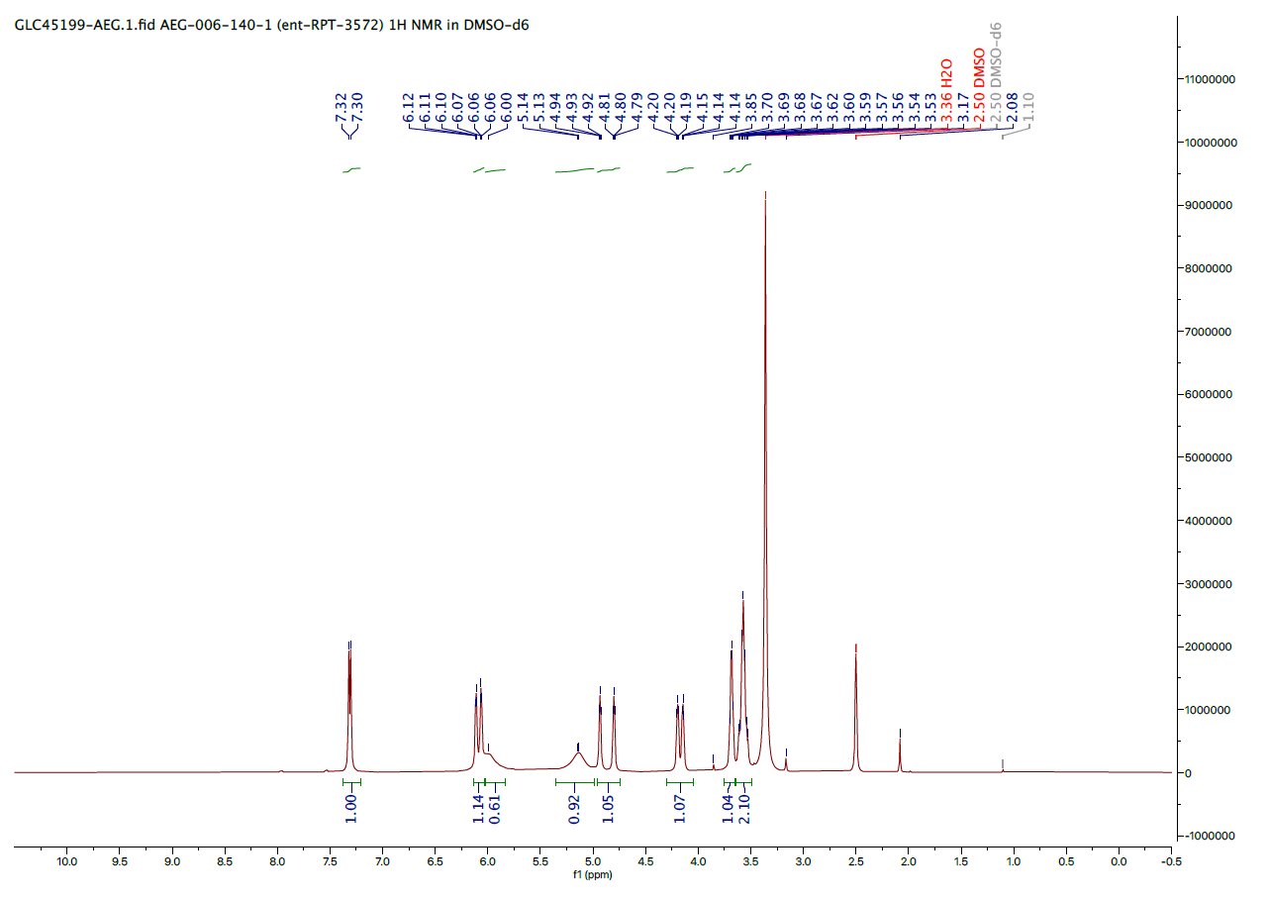
¹H NMR - ent-RPT-3572:
CONFIDENTIAL

Slide 23
LCMS - ent-RPT-3572:
[2(M-Cs)+Na]⁺
[M-Cs+H]⁺
CONFIDENTIAL

Slide 24
HPLC - ent-RPT-3572:
CONFIDENTIAL

Slide 25
Ent-RPT-3576: Repeat Step 4
Entry # | Scale | Description | Comments
1 | 8.22 g | SM ent-RPT-3572 (8.22 g, 1 eq), Imidazole (5 eq), TIPS-Cl (4 eq), Acetonitrile (60 mL), 60 °C, 8 h; then 50 °C O/N; then added Imidazole (1 eq), TIPS-Cl (1 eq), 60 °C, 5 h. | Obtained 8.83 g (74%) white solid after workup & column NMR: In agreement with structure, matched previous batch HPLC: t_{R} = 10.54 min (99.1 %) LCMS: m/z = 577⁺ [M+H]⁺
CONFIDENTIAL

Slide 26
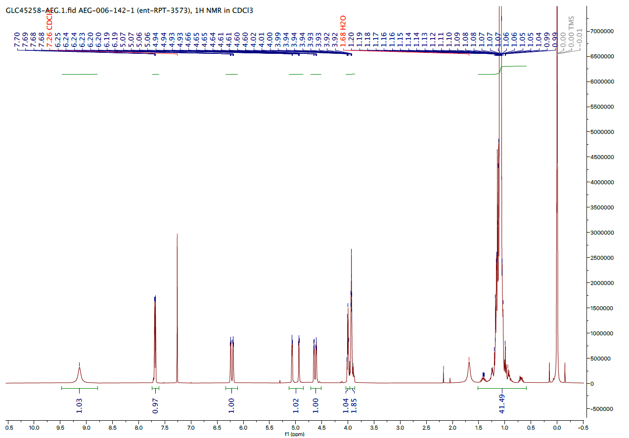
¹H NMR - ent-RPT-3573:
CONFIDENTIAL

Slide 27
LCMS - ent-RPT-3573:
CONFIDENTIAL

Slide 28
HPLC - ent-RPT-3573:
CONFIDENTIAL

Slide 29
Ent-RPT-3576: Repeat Step 5
Entry # | Scale | Description | Comments
1 | 8.83 g | SM ent-RPT-3573 (8.83 g, 1 eq), HCl (3M/MeOH, 1.75 eq), 0 °C-RT, MeOH (120 mL), O/N, then HCl (0.3 eq), RT, 5 h | Obtained 5.30 g (82%) after column LCMS: m/z = 421⁺ [M+H]⁺ was the major species NMR: in agreement with desired structure; matched with previous batch HPLC (97%)
CONFIDENTIAL

Slide 30
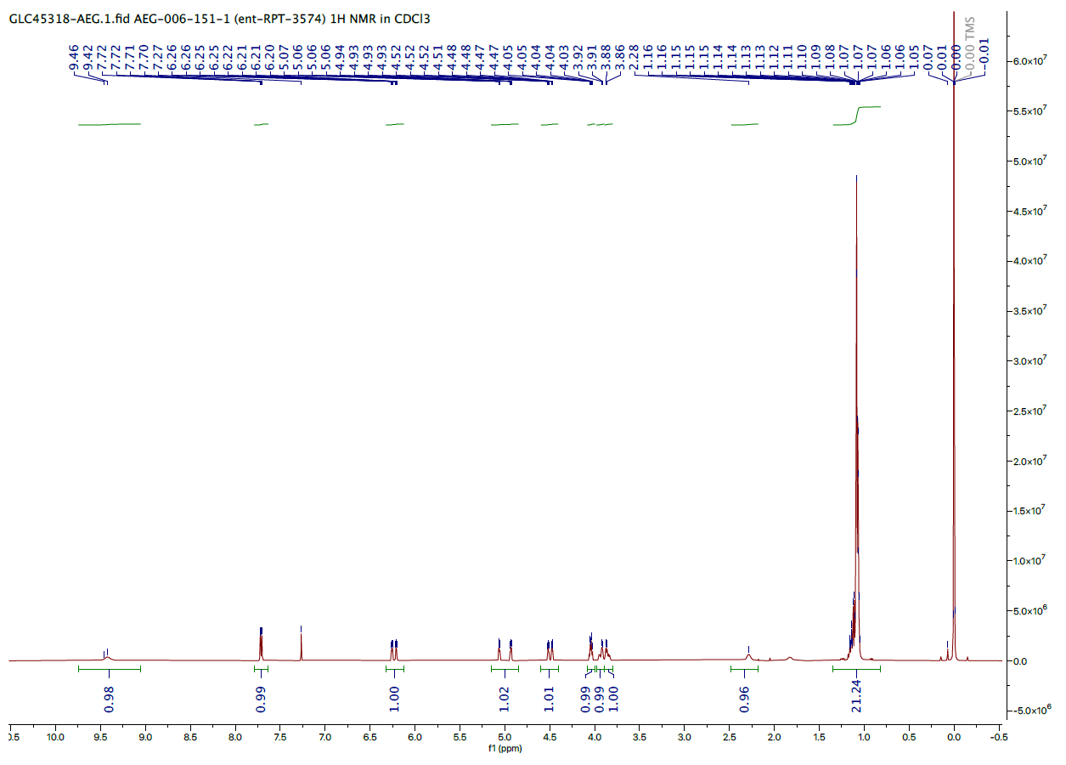
¹H NMR - ent-RPT-3574:
CONFIDENTIAL

Slide 31
LCMS - ent-RPT-3574:
CONFIDENTIAL

Slide 32
HPLC - ent-RPT-3574:
CONFIDENTIAL

Slide 33
Ent-RPT-3576: Step 6
Entry # | Scale | Description | Comments
1 | 3.45 g | SM ent-RPT-3574 (3.45 g, 1 eq), TEMPO (0.1 eq), NaBr (0.2 eq), NaClO (pH = 9.4, 1.25 eq), 5-15 °C, DCM (86 mL), NaHCO₃/K₂CO₃ (pH = 9.2, 86 mL), 1 h | HPLC (ORG): ent-RPT-3574 (0.7%), ent-RPT-2950-1B (6.2%), ent-RPT-3575 (93.0%) HPLC (AQ): Substantial signal from ent-RPT-2950-1B Extractive workup (MTBE); crude used directly for next step
2 | 3.0 g | SM ent-RPT-3574 (3.0 g, 1 eq), TEMPO (0.1 eq), NaBr (0.2 eq), NaClO (pH = 9.4, 1.25 eq), 5-15 °C, DCM (75 mL), NaHCO₃/K₂CO₃ (pH = 9.2, 75 mL), 1 h | HPLC: RPT-3574 (0.3%), RPT-2950-1B (5.2%), RPT-3575 (94.6%); included hydrate in integration LCMS:m/z = 419⁺ [M+H]⁺ major species HPLC (AQ): Substantial signal from ent-RPT-2950-1B Extractive workup (MTBE); crude used directly for next step
3 | 2.3 g | SM ent-RPT-3574 (2.3 g, 1 eq), TEMPO (0.1 eq), NaBr (0.2 eq), NaClO (pH = 9.4, 1.25 eq), 5-15 °C, DCM (60 mL), NaHCO₃/K₂CO₃ (pH = 9.2, 60 mL), 1 h | HPLC: RPT-3574 (1.8%), RPT-2950-1B (1.0%), RPT-3575 (97.1%) HPLC (AQ): Substantial signal from ent-RPT-2950-1B Extractive workup (MTBE); crude used directly for next step
CONFIDENTIAL

Slide 34
HPLC - Entry 1 (1 h):
ent-RPT-3574
ent-RPT-3575
ent-RPT-2950-1B
CONFIDENTIAL

Slide 35
HPLC - Entry 2: Organic Layer After Extraction
ent-RPT-3575
(Hydrate)
CONFIDENTIAL

Slide 36
LCMS - Entry 2: Organic Layer After Extraction
CONFIDENTIAL

Slide 37
HPLC - Entry 3:
ent-RPT-3574
ent-RPT-3575
ent-RPT-2950-1B
CONFIDENTIAL

Slide 38
HPLC - Entry 3: Organic vs. Aqueous Layers After Extraction
Organic
ent-RPT-3575
Aqueous
ent-RPT-2950-1B
CONFIDENTIAL

Slide 39
Ent-RPT-3576: Step 7-8
Entry # | Scale | Description | Comments
1 | ~3.45 g | SM ent-RPT-3575 (assumed ~3.45 g, 1 eq), Formaldehyde (37% aq, 2 V ~10 eq), NaOH (2M, 2.2 V, ~2 eq), Dioxane (35 mL) 0°C-RT, 16 h NaBH₄, 2.5 eq, 0 °C-RT, 2 h; then NaBH₄ (2.5 eq), 2 h, RT | Obtained 1.19 g white solid after workup and chromatography (32% for 3 steps) Further addition of 2.5 eq NaBH4 after 2h reduction step to give complete reaction HPLC: (95.9%) LCMS: m/z = 451⁺ [M+H]⁺ NMR: acquisition in progress
2 | ~3.0 g | SM ent-RPT-3575 (assumed ~3.0 g, 1 eq), Formaldehyde (37% aq, 2 V ~10 eq), NaOH (2M, 2.2 V, ~2 eq), Dioxane (30 mL) 0 °C-RT, 16 h NaBH₄, 5 eq, 10 °C-RT, 4 h | Purification in progress
3 | ~2.3 g | SM ent-RPT-3575 (assumed ~3.0 g, 1 eq), Formaldehyde (37% aq, 2 V ~10 eq), NaOH (2M, 2.2 V, ~2 eq), Dioxane (25 mL) 0 °C-RT, 16 h NaBH₄, 5 eq, 10 °C-RT, 4 h | Workup & purification in progress
CONFIDENTIAL

Slide 40
LCMS – Step 7 O/N:
CONFIDENTIAL

Slide 41
LCMS - ent-RPT-3576:
Column Product
CONFIDENTIAL

Slide 42
HPLC - ent-RPT-3576: Column Product
CONFIDENTIAL

Slide 43
Conclusions
Oxidation Troubleshooting:
  Focused on TEMPO/NaClO system to reproduce and improve upon previous encouraging results
  Carried 5 g scale reactions successfully through formylation/reduction steps to give RPT-3576
  Additionally tested MTBE as organic reaction solvent to simplify quench and work-up
  Yield = 53-67% over 3 steps, optimization on-going
  Purity = 78-87% (HPLC) after crystallization
  Acid RPT-002950-1B remained a persistent impurity; further observed in aqueous extracts and in reaction aqueous layer.
Synthesis of ent-RPT-003576:
  Repeated Step 3 (ent-RPT-3572); yield = 8.22 g (89%)
  Repeated Step 4 (ent-RPT-3573); yield = 8.83 g (74%)
  Repeated Step 5 (ent-RPT-3574); yield = 5.30 g (82%)
  Repeated Steps 6-8 (ent-RPT-3576) at 2 g, 2 x 3 g scale
  Yield = 1.19 g (32%, 3 steps), purity 95.9% (1st Batch)
  Oxidations completed with TEMPO/NaClO system

Slide 44
Thank You!

